Slide 1

“Towards Global Technological Excellence”
GOVERNMENT COLLEGE OF ENGINEERING AMRAVATI
An Autonomous Institute of Government of Maharashtra
FruitSack : AI-Driven Fruit Pricing
Group Members
18005057 | Shubham Narsing Rathod
20105001 | Prasad Madhukar Shembekar
20105003 | Abhay Dinesh Meshram
20105005 | Mobin Shamshoddin Shaikh
20105006 | Siddhesh Sanjay Kalamkar
Guided by:-
Prof. R.V. Mante
Head of Department:-
Prof. A.V. Deorankar

Slide 2
CONTENTS
Objectives
CNN
Modules
Technologies Required
Conclusion
References

Slide 3
Objectives
To develop an online fruits quality detection system using machine learning techniques
To implement CNN algorithm for fruits quality detection
To implement quality wise price calculation module

Slide 4
CNN
Convolutional Neural Network, also known as convnets or CNN, is a well-known method in computer vision applications. It is a class of deep neural networks that is used to analyze visual imagery. This type of architecture is dominant to recognize objects from a picture or video. It is used in applications like image or video recognition, neural language processing, etc.

Slide 5
CNN Definition
A CNN uses filters on the raw pixel of an image to learn details pattern compare to global pattern with a traditional neural net. To construct a CNN, you need to define:
  A convolutional layer: Apply n number of filters to the feature map. After the convolution, you need to use a Relu activation function to add non-linearity to the network.
  Pooling layer: The next step after the convolution is to downsample the feature max. The purpose is to reduce the dimensionality of the feature map to prevent overfitting and improve the computation speed. Max pooling is the conventional technique, which divides the feature maps into subregions (usually with a 2x2 size) and keeps only the maximum values.
  Fully connected layers: All neurons from the previous layers are connected to the next layers. The CNN will classify the label according to the features from the convolutional layers and reduced with the pooling layer.

Slide 6
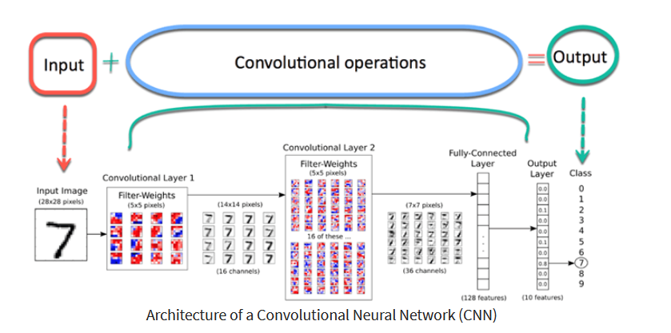
CNN Architecture

Slide 7
Modules
Admin Panel
Data Set Generation
Fruits Seller Panel
User Management
Fruits Quality Detection
Price Calculation

Slide 8
Admin Panel
Login
View fruit sellers
View users
Register category wise price reduction percentage
Generate Dataset
  Register fruits
  Upload fruits images for various types of quality

Slide 9
Data Set Generation
Register Qualities
  Fresh
  Good
  Normal
  Rotten
  Worst
Upload fruit image
Convert image into thumbnail
Convert it into gray scale
Feature extraction
Store features in database

Slide 10
Fruits Seller Panel
Register
Login
Upload Fruits to sell
Update price
Manage stock
View pending orders
Process orders
View Fruit quality wise detected order price
View ratings

Slide 11
User Management
Registration
Login
Change password
Password recovery
Browse fruit market online
Place order
View order details
Upload fruits photos after receiving order
Get calculated price
Pay final price offline

Slide 12
Fruits Quality Detection
Upload fruit photo
Fruit image preprocessing
Feature extraction
Quality detection using CNN algorithm

Slide 13
Price Calculation
Quality detection of few fruits from the order
Submit more information about the order
  How many fruits are rotten?
  How many fruits are fresh? etc
Price calculation

Slide 14
Technologies required (.Java)
Deployment Platform: Windows
Application Server: JBoss AS7/Apache Tomcat/GlassFish
Technology : Java EE 17
Development Tools (Serverside): Servlets & JSP,Java Beans
MVC framework : Spring Boot
Database technologies: MySQL,JDBC
Web Development: XML, HTML, DHTML, Javascript,AJAX
Development Tool: Eclipse IDE 2022-06
Python for algorithms
Xampp apache server

Slide 15
Technologies required (Python)
Deployment Platform: Windows
Application Server: xampp apache server
Language : python
Development Tool: Visual Studio Code

Slide 16
Advantages
Advantages
Easy to use
The application is very easy to use for administrator and customers. The administrator will be able to increase the fruits categories and their images in dataset from his web panel.
Beneficial for customers
Customers will get the products in affordable and correct cost according to the quality of the fruits.

Slide 17
Helping user to get reasonable fruits with reduced cost of damaged fruits
Limitations
Limited Dataset can be the real issue while dealing with it but it can be easily overcomes by using powerful datasets provided by kaggle and some system with high computing power

Slide 18
Conclusion
A new method for classifying fruits using a convolutional neural network algorithm has been carried out. In the proposed system, a model is introduced to recognize fruits from images. During this type of work, machine learning approaches have been developed to establish the model. In this study, a fruit dataset of 4 classes was introduced for introduction. To perform the model task, Convolutional Neural Networks (CNNs) were used, which were developed to carry out a machine learning approach. This model is able to get an accuracy of 99.89%, which proves that the performance of this model to recognize fruit from images is more advanced. The high accuracy of the model shows that CNN is very suitable for this kind of fruit recognition and also found a good algorithm for CNN which has been successfully implemented for fruit recognition. As we proposed dynamic dataset generation process, administrator will be able to increase the fruits types any time. Administrator has facility to train the dataset from web application. Therefore it is very easy for the administrator to handle dataset. We can conclude that our proposed system is very beneficial for customers.

Slide 19
References
Krithika Jayasankar, Karthika B, “Fruit freshness detection using raspberry pi” International Journal of Pure and Applied Mathematics, 1685-1691 ISSN:1314-339,pp:1685-1690, 2018.
Mandeep Kaur, Reecha Sharma, “ANN based Technique for Vegetable Quality Detection, IOSR Journal of Electronics and Communication Engineering”, ISSN: 2278-8735, pp:62-70, 2015.
S.M. Shirsath, Sumit S. Telang , “Fruit Quality Inspection using Image Processing”, Journal of Springer, ISSN:2395-4396, pp:1355-1359, 2015.

Slide 20
Thank You

